Slide 1
GUI Basics

Slide 2
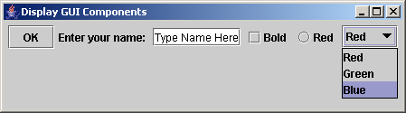
Creating GUI Objects
// Create a button with text OK
JButton jbtOK = new JButton("OK");
// Create a label with text "Enter your name: "
JLabel jlblName = new JLabel("Enter your name: ");
// Create a text field with text "Type Name Here"
JTextField jtfName = new JTextField("Type Name Here");
// Create a check box with text bold
JCheckBox jchkBold = new JCheckBox("Bold");
// Create a radio button with text red
JRadioButton jrbRed = new JRadioButton("Red");
// Create a combo box with choices red, green, and blue
JComboBox jcboColor = new JComboBox(new String[]{"Red",
"Green", "Blue"});
Label
Text field
Check Box
Radio Button
Button
Combo Box

Slide 3
Swing vs. AWT
AWT is fine for developing simple graphical user interfaces, but not for developing comprehensive GUI projects.
With the release of Java 2, the AWT user-interface components were replaced by a more robust, versatile, and flexible library known as Swing components.
Swing components are less dependent on the target platform and use less of the native GUI resource.
For this reason, Swing components that don’t rely on native GUI are referred to as lightweight components, and AWT components are referred to as heavyweight components.

Slide 4
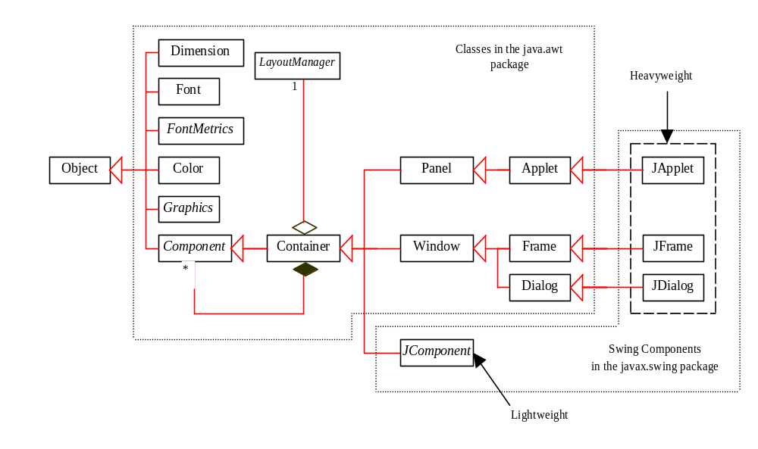
GUI Class Hierarchy (Swing)

Slide 5
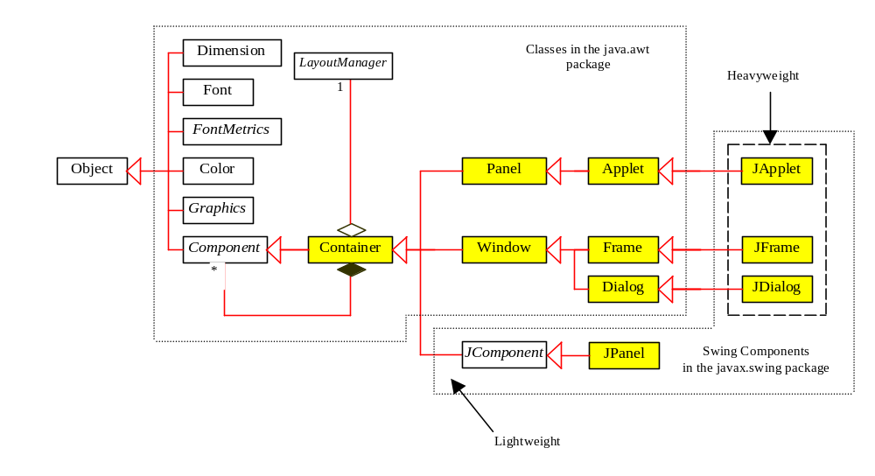
Container Classes
Container classes can contain other GUI components.

Slide 6
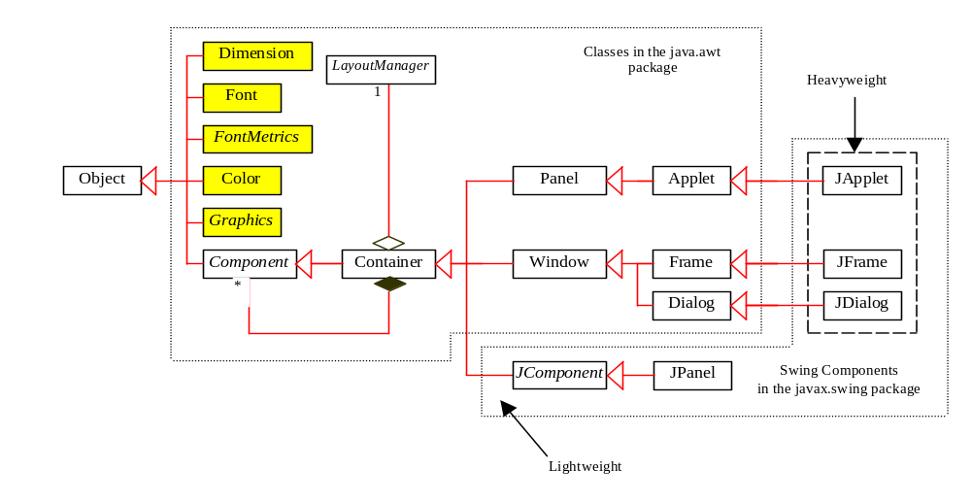
GUI Helper Classes
The helper classes are not subclasses of Component. They are used to describe the properties of GUI components such as graphics context, colors, fonts, and dimension.

Slide 7
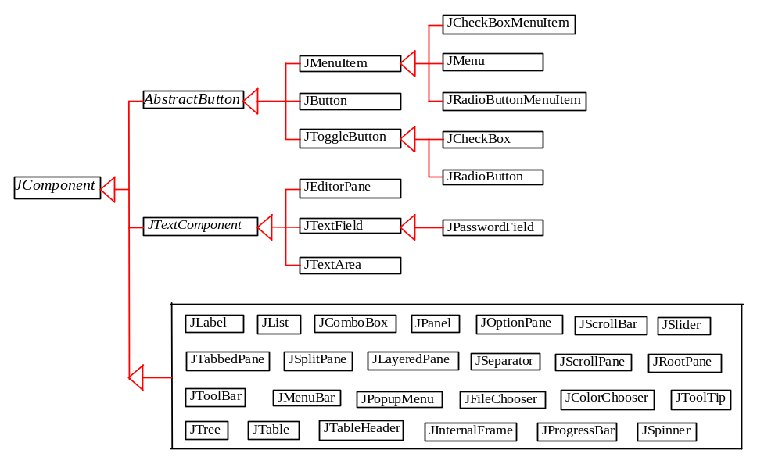
Swing GUI Components

Slide 8
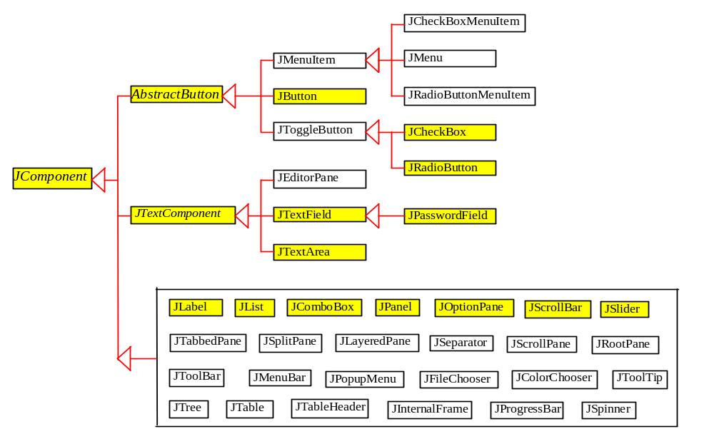
Components Covered in the Core Version

Slide 9
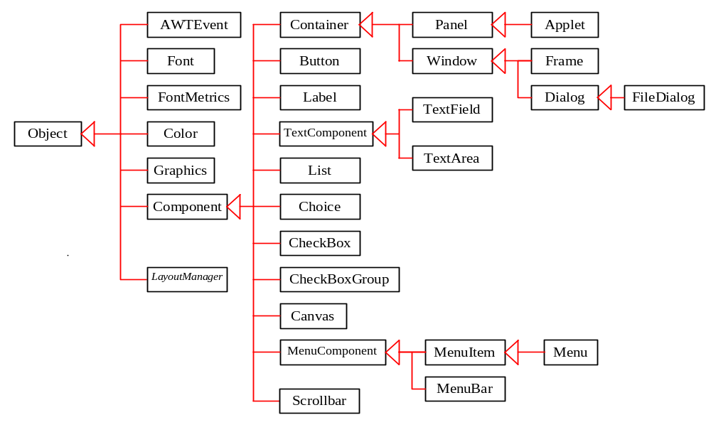
AWT (Optional)

Slide 10
Frames
Frame is a window that is not contained inside another window. Frame is the basis to contain other user interface components in Java GUI applications.
The JFrame class can be used to create windows.
For Swing GUI programs, use JFrame class to create widows.

Slide 11
Creating Frames
  import javax.swing.*;
  public class MyFrame {
  public static void main(String[] args) {
  JFrame frame = new JFrame("Test Frame");
  frame.setSize(400, 300);
  frame.setVisible(true);
  frame.setDefaultCloseOperation(
  JFrame.EXIT_ON_CLOSE);
  }
}
MyFrame
Run

Slide 12
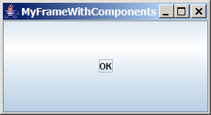
Adding Components into a Frame
// Add a button into the frame
frame.getContentPane().add(
new JButton("OK"));
Title bar
Content pane
MyFrameWithComponents

Slide 13
Content Pane Delegation in JDK 1.5
// Add a button into the frame
frame.getContentPane().add(
new JButton("OK"));
Title bar
// Add a button into the frame
frame.add(
new JButton("OK"));
Content pane
MyFrameWithComponents

Slide 14
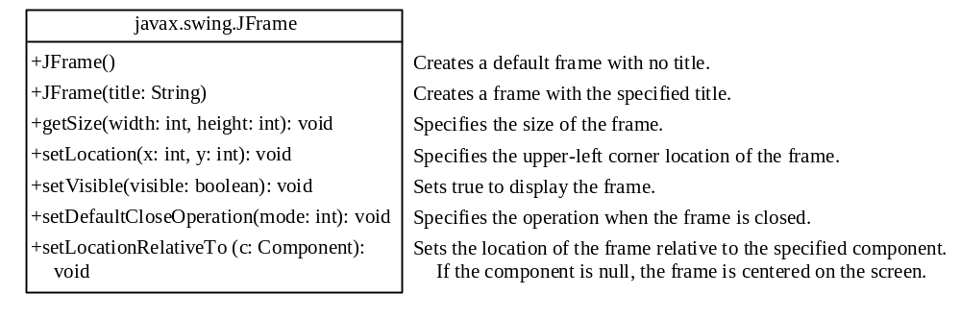
JFrame Class

Slide 15
Layout Managers
Java’s layout managers provide a level of abstraction to automatically map your user interface on all window systems.
The UI components are placed in containers. Each container has a layout manager to arrange the UI components within the container.
Layout managers are set in containers using the setLayout(LayoutManager) method in a container.

Slide 16
Kinds of Layout Managers
FlowLayout
GridLayout
BorderLayout
Several other layout managers …

Slide 17
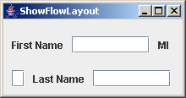
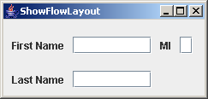
FlowLayout Example
Write a program that adds three labels and text fields into the content pane of a frame with a FlowLayout manager.
ShowFlowLayout

Slide 18
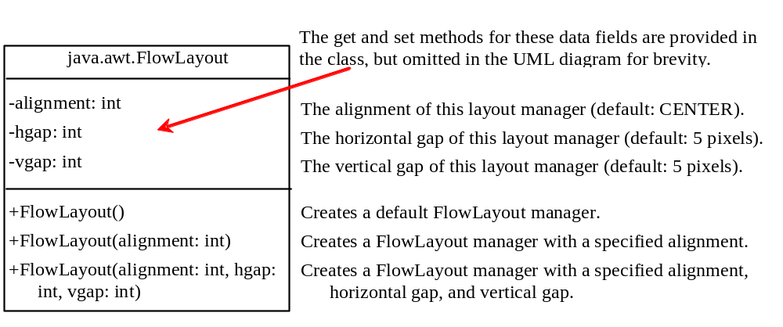
The FlowLayout Class

Slide 19
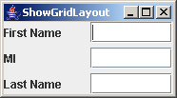
GridLayout Example
Rewrite the program in the preceding example using a GridLayout manager instead of a FlowLayout manager to display the labels and text fields.
ShowGridLayout

Slide 20
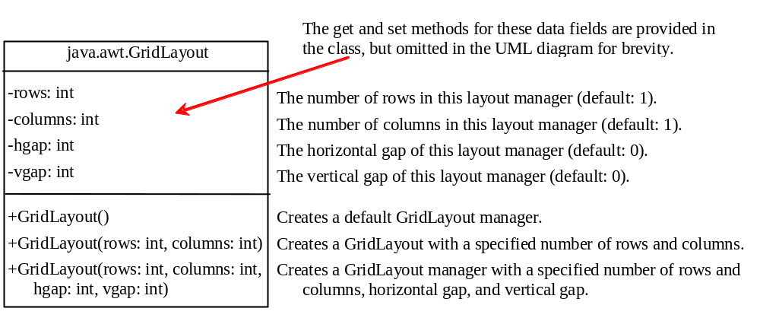
The GridLayout Class

Slide 21
The BorderLayout Manager
The BorderLayout manager divides the container into five areas: East, South, West, North, and Center. Components are added to a BorderLayout by using the add method.
add(Component, constraint), where constraint is BorderLayout.EAST, BorderLayout.SOUTH, BorderLayout.WEST, BorderLayout.NORTH, or BorderLayout.CENTER.

Slide 22
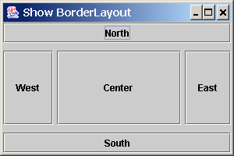
BorderLayout Example
ShowBorderLayout

Slide 23
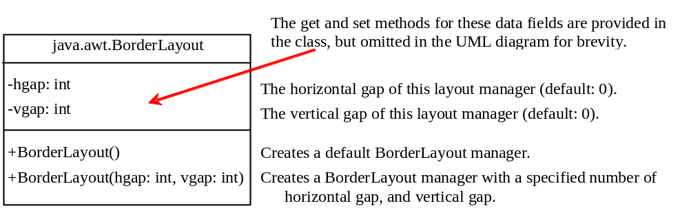
The BorderLayout Class

Slide 24
The Color Class
You can set colors for GUI components by using the java.awt.Color class. Colors are made of red, green, and blue components, each of which is represented by a byte value that describes its intensity, ranging from 0 (darkest shade) to 255 (lightest shade). This is known as the RGB model.
  Color c = new Color(r, g, b);
r, g, and b specify a color by its red, green, and blue components.
Example:
  Color c = new Color(228, 100, 255);

Slide 25
Standard Colors
Thirteen standard colors (black, blue, cyan, darkGray, gray, green, lightGray, magenta, orange, pink, red, white, yellow) are defined as constants in java.awt.Color.
The standard color names are constants, but they are named as variables with lowercase for the first word and uppercase for the first letters of subsequent words.
Since JDK 1.4, you can also use the new constants: BLACK, BLUE, CYAN, DARK_GRAY, GRAY, GREEN, LIGHT_GRAY, MAGENTA, ORANGE, PINK, RED, WHITE, and YELLOW.

Slide 26
Setting Colors
You can use the following methods to set the component’s background and foreground colors:
  setBackground(Color c)
  setForeground(Color c)
Example:
  jbt.setBackground(Color.yellow);
  jbt.setForeground(Color.red);

Slide 27
The Font Class
Font Names
  Standard font names that are supported in all platforms are: SansSerif, Serif, Monospaced, Dialog, or DialogInput.
Font Style
  Font.PLAIN (0), Font.BOLD (1), Font.ITALIC (2), and Font.BOLD + Font.ITALIC (3)
Font myFont = new Font(name, style, size);
Example:
  Font myFont = new Font("SansSerif ", Font.BOLD, 16);
  Font myFont = new Font("Serif", Font.BOLD+Font.ITALIC, 12);
  JButton jbtOK = new JButton("OK“);
  jbtOK.setFont(myFont);

Slide 28
Finding All Available Font Names
GraphicsEnvironment e =
GraphicsEnvironment.getLocalGraphicsEnvironment();
String[] fontnames = e.getAvailableFontFamilyNames();
for (int i = 0; i < fontnames.length; i++)
System.out.println(fontnames[i]);

Slide 29
Using Panels as Sub-Containers
Panels act as sub-containers for grouping user interface components.
It is recommended that you place the user interface components in panels and place the panels in a frame. You can also place panels in a panel.
To add a component to JFrame, you actually add it to the content pane of JFrame. To add a component to a panel, you add it directly to the panel using the add method.

Slide 30
Creating a JPanel
You can use new JPanel() to create a panel with a default FlowLayout manager or new JPanel(LayoutManager) to create a panel with the specified layout manager. Use the add(Component) method to add a component to the panel. For example,
JPanel p = new JPanel();
p.add(new JButton("OK"));

Slide 31
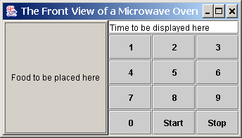
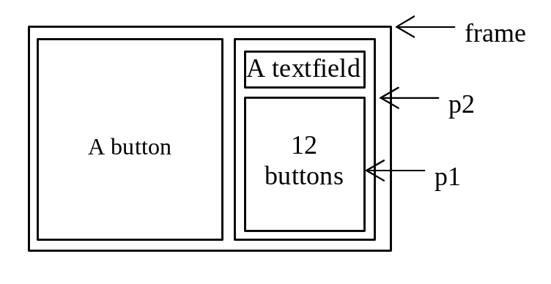
Testing Panels Example
This example uses panels to organize components. The program creates a user interface for a Microwave oven.
TestPanels

Slide 32
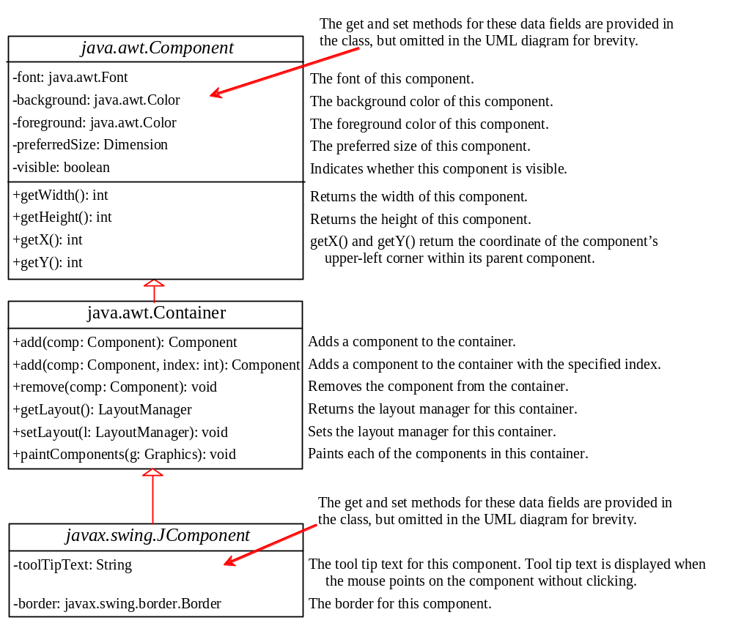
Common Features of Swing Components

Slide 33
Borders
You can set a border on any object of the JComponent class. Swing has several types of borders. To create a titled border, use
  new TitledBorder(String title).
To create a line border, use
  new LineBorder(Color color, int width),
where width specifies the thickness of the line. For example, the following code displays a titled border on a panel:
  JPanel panel = new JPanel();
  panel.setBorder(new TitleBorder(“My Panel”));

Slide 34
Test Swing Common Features
Component Properties
font
background
foreground
preferredSize
minimumSize
maximumSize
JComponent Properties
toolTipText
border
TestSwingCommonFeatures

Slide 35
Image Icons
Java uses the javax.swing.ImageIcon class to represent an icon. An icon is a fixed-size picture.
Images are normally stored in image files. You can use new ImageIcon(filename) to construct an image icon.
For example, the following statement creates an icon from an image file us.gif in the image directory under the current class path:
ImageIcon icon = new ImageIcon("image/us.gif");
TestImageIcon

